Slide 1
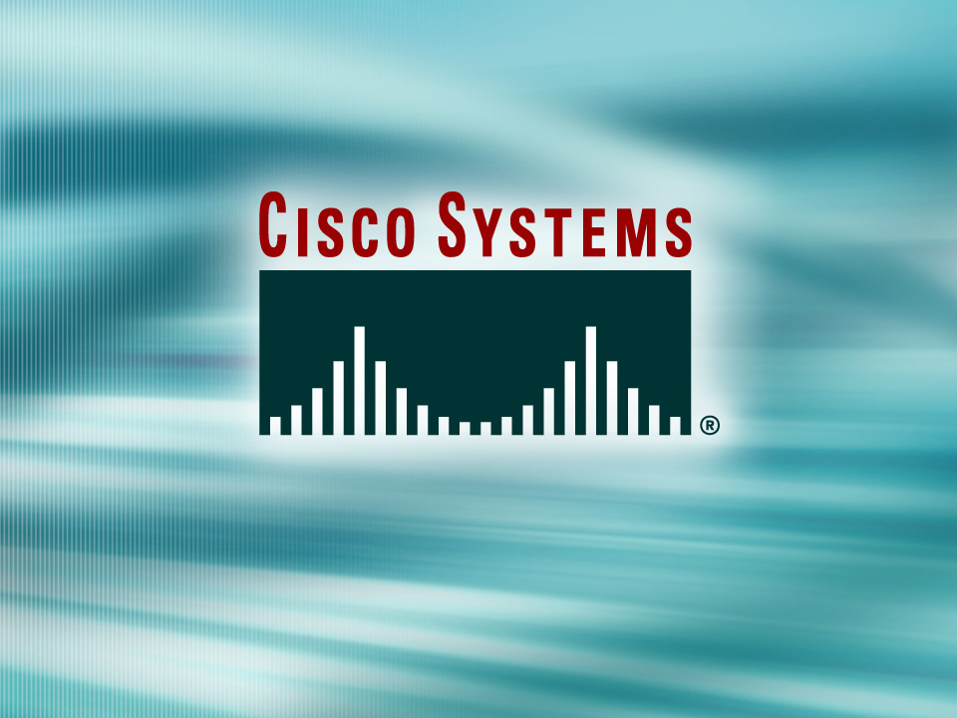
© 2002, Cisco Systems, Inc. All rights reserved.

Slide 2
Operating and Configuring Cisco IOS Devices
Module 1
Notes:
Purpose: This chapter introduces the Cisco IOS™ CLI on the Catalyst® 1900 switch and router.
Timing: This chapter should take about 2 hours to present.
Note: The Catalyst 1900 switch only has a subset of the router Cisco IOS commands available.
Contents:
Introduction to Cisco IOS. Explain to the student what is IOS?
Cisco Device startup procedures in general.
IOS configuration source.
General introduction to the IOS CLI.
Cat 1900 switch startup procedures.
Intro to Cat 1900 CLI. This part covers the basic configuration on the switch, like setting the IP address and hostname. More details about the various Cat 1900 switch configuration commands are explained in Chapter 6 and 7.
Router startup procedures. More details on the router startup process is discussed in chapter 5.
Router IOS CLI.

Slide 3
Objectives
Upon completing this module, you will be able to:
  Use the available configuration tools to establish connectivity to the appropriate network device in order to complete the initial device configuration
  Verify the default configuration of each device, given a functioning access layer switch and router
Notes:
Slide 1 of 2
Purpose: This slide states the chapter objectives.
Emphasize: Read or state each objective so that each student has a clear understanding of the chapter objectives.
Note: Catalyst switches have different CLIs. The Catalyst 2900xl and the Catalyst 1900 has a Cisco IOS CLI. The Cisco IOS CLI commands available on the 2900xl is different from the 1900. The Catalyst 5000 family has no Cisco IOS CLI, and use the set commands instead. This class only covers the configuration on the Catalyst 1900 switch.

Slide 4

Operating Cisco IOS Software
© 2002, Cisco Systems, Inc. All rights reserved.
Notes:
Purpose: This chapter introduces the Cisco IOS™ CLI on the Catalyst® 1900 switch and router.
Timing: This chapter should take about 2 hours to present.
Note: The Catalyst 1900 switch only has a subset of the router Cisco IOS commands available.
Contents:
Introduction to Cisco IOS. Explain to the student what is IOS?
Cisco Device startup procedures in general.
IOS configuration source.
General introduction to the IOS CLI.
Cat 1900 switch startup procedures.
Intro to Cat 1900 CLI. This part covers the basic configuration on the switch, like setting the IP address and hostname. More details about the various Cat 1900 switch configuration commands are explained in Chapter 6 and 7.
Router startup procedures. More details on the router startup process is discussed in chapter 5.
Router IOS CLI.

Slide 5
Objectives
Upon completing this lesson, you will be able to:
  Set up console connections between Cisco network devices and a terminal, given a need to configure and monitor network equipment
  Describe the features of the Cisco IOS user interface
  Identify the differences between the user EXEC and privileged EXEC modes
Notes:
Slide 1 of 2
Purpose: This slide states the chapter objectives.
Emphasize: Read or state each objective so that each student has a clear understanding of the chapter objectives.
Note: Catalyst switches have different CLIs. The Catalyst 2900xl and the Catalyst 1900 has a Cisco IOS CLI. The Cisco IOS CLI commands available on the 2900xl is different from the 1900. The Catalyst 5000 family has no Cisco IOS CLI, and use the set commands instead. This class only covers the configuration on the Catalyst 1900 switch.

Slide 6
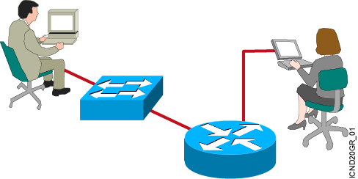
Cisco IOS Software Features
Cisco IOS software delivers network services and enables networked applications.
Notes:
Purpose: This slide introduces Cisco IOS software.
Emphasize: Use this slide for your first introduction of Cisco IOS software to your students. Cisco IOS software is the platform that delivers network services for the network applications. This Cisco IOS software platform extends beyond the routers. Cisco IOS also applies to selected Catalyst switches. Eventually, all Cisco platforms may merge to the Cisco IOS software.
Note: The Catalyst 1900 and 2900xl switch Cisco IOS has a common look and feel like the router’s Cisco IOS. However, the switch Cisco IOS is not 100 percent identical to the router’s Cisco IOS.

Slide 7
Configuring Network Devices
  Configuration sets up the device with the following:
    Network policy of the functions required
    Protocol addressing and parameter settings
    Options for administration and management
  Catalyst switch memory has initial configuration with default settings
  Cisco router will prompt for initial configuration if there is no configuration in memory
Notes:
Purpose: This slide discuss the initial configurations on the routers and switches.
Note: There is no setup mode on the Catalyst 1900 switch.

Slide 8
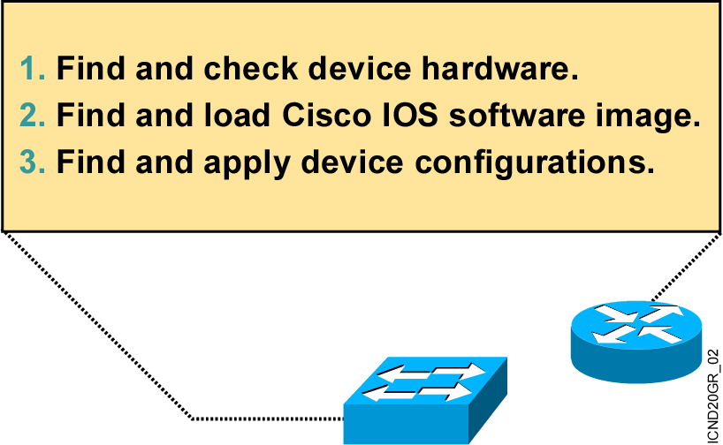
An Overview of Cisco Device Startup
Notes:
Purpose: This slide introduces the startup process on Cisco routers and switches.
Emphasize: Paraphrase or restate the three points and make sure your students follow the description. This description is necessary to keep a common perspective of what is occurring on the switch and the router; these three steps should be an anchor to return to as needed.
Transition: Where are the sources for configuration software?

Slide 9
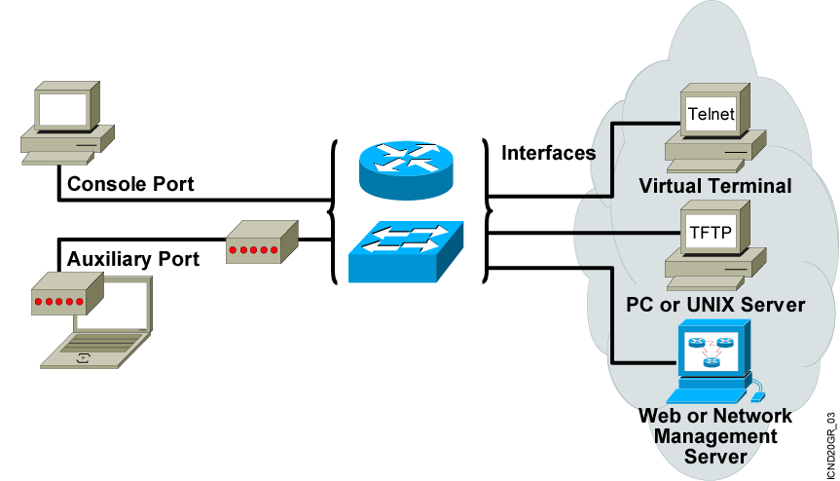
External Configuration Sources
Configurations can come from many sources.
Configurations will act in device memory.
Notes:
Purpose: This slide describes the different ways students can access the Catalyst switch or Cisco router to create a new configuration file or alter an existing one.
Emphasize: The network device can be configured from several locations. After you create the initial configuration, you can configure the ports or interfaces to enable configuration over virtual terminal ports (vty).
Both the router and switch support Telnet access as a virtual terminal.
The router by default supports virtual terminals 0 through 4. The router can be accessed for configuration purposes from the console port, the auxiliary port, and five VTY lines at the same time—up to seven people can configure the router at once.
You should caution students about the above point and inform them that security should be strictly observed through password protection to avoid unauthorized access of the configuration files.
Another component important to configuration in the network is a TFTP server.
The TFTP server can be a UNIX or PC workstation that acts as a central depository for files.
You can keep configuration files on the TFTP server and then download them to the device.
You can also configure them from a network management station running network management software such as CWSI, CiscoWorks, or HP OpenView. Before you can access or change the configuration from a virtual terminal, TFTP server, or network management station, you must have the device configured to support IP traffic.

Slide 10
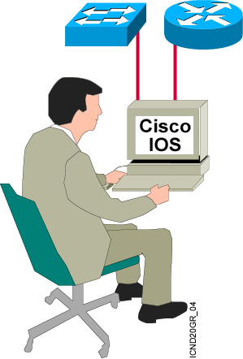
Cisco IOS User Interface Functions
  A CLI is used to enter commands.
  Operations vary on different internetworking devices.
  Users type or paste entries in the console command modes.
  Enter key instructs device to parse and execute the command.
  Two primary EXEC modes are user mode and privileged mode.
  Command modes have distinctive prompts.
Notes:
Purpose: This slide introduces the two Cisco IOS EXEC modes on the Catalyst 1900 switch and routers.
Emphasize: As you present this, describe the bullet points that can prepare your students to work with the Cisco IOS user interface.

Slide 11
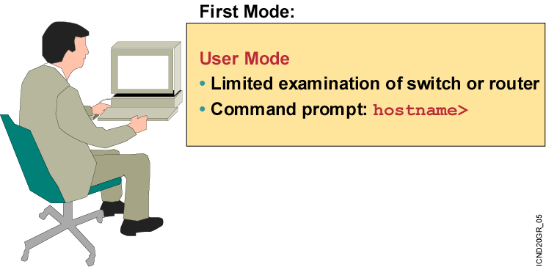
Cisco IOS Software EXEC Mode
There are two main EXEC modes for entering commands.
Notes:
Slide 1 of 2
Purpose: This slide describes the user EXEC mode.
Emphasize: Present the operational aspects of user EXEC mode.
Tell your students that this command level allows them to access only a limited amount of basic monitoring commands.
Emphasize that they need to look carefully at the command prompter to make sure that they are in the appropriate mode for the command that they want to enter into the network device. If your class can remember this, this will eliminate (or at least reduce) the number of times that you have to point out that a lab step is failing because the student is in user mode rather than in enabled mode.
Transition: An introduction of privileged (or enabled) mode.

Slide 12
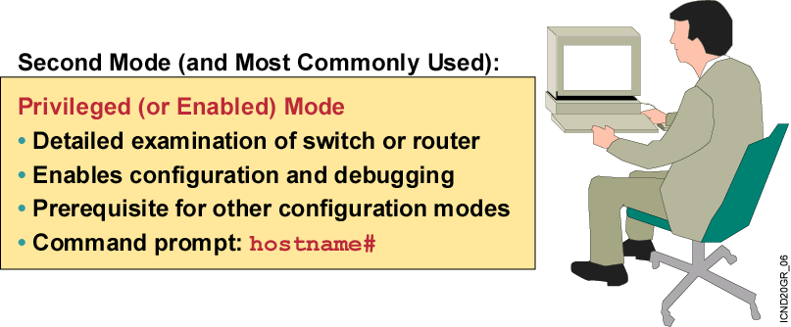
Cisco IOS Software EXEC Mode (Cont.)
Notes:
Slide 2 of 2
Purpose: This slide describes the privileged EXEC mode.
Emphasize: As you present the introductory material on privileged (also called “enabled”) mode, emphasize that this mode is the entry mode for all other configuration modes. Tell your students that they will need this mode for ICND labs and most of the network administration that they do back on the job.
Use the analogy of “the price of admission.” You must enter enable followed by the correct enable password; otherwise, you will not get into the network device; and will have to stay outside in user mode where you can only see a few basic things about the network device.
Note: This slide ends the introductory material that is common to the network devices covered in ICND.
Transition: Material specific to the initial startup of the Catalyst switch.

Slide 13
Summary
  The Cisco IOS software platform is implemented on all Cisco hardware platforms.
  You will use Cisco IOS software to communicate the configuration details that implement the learning objectives of this course.
  You can configure a switch or router from sources that are external to the device.
  Cisco IOS software uses a CLI as its traditional console environment. While Cisco IOS software is a core technology, Cisco IOS software operation details vary on different internetworking devices.
  The Cisco IOS software supports two EXEC command modes: user and privileged.
Notes:
Purpose: This slide discuss the initial configurations on the routers and switches.
Note: There is no setup mode on the Catalyst 1900 switch.

Slide 14


